Slide 1
Wine Dataset
Machine Learning Algorithms

Slide 2
About Dataset
This dataset contains chemical compositions of 1600 Wines. Also there are some duplicate values as well.
The two most important features among all 12 attributes are Sulphur dioxide (both free and total) and Alcohol.
However the most important factor to decide the quality of a wine is Alcohol, higher concentration of alcohol leads to better quality.
Volatile acidity contributes to acidic tastes and have a negative correlation with quality

Slide 3
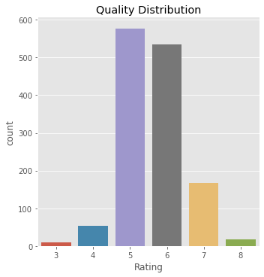
Data Analysis
The following plot shows the count of wines for each quality.
We can conclude that most of the wines in our sample have a rating of 5.
There are only few wines (less than 50) which have been rated as 8 (best among these).

Slide 4
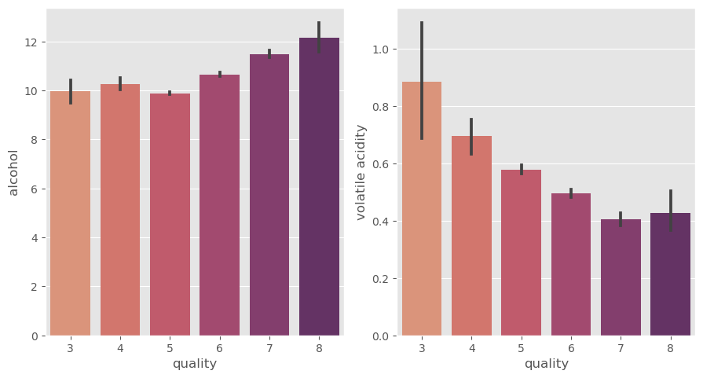
Contribution of Alcohol and Volatile Acidity in quality
Alcohol has a positive correlation with the quality whereas volatile acidity has a negative correlation.
Higher concentration of alcohol leads to better quality whereas volatile acidity contributes to acidic taste.

Slide 5
Applied Models
I have applied 3 different models for predicting the quality of a wine based on 12 components :
Logistic Regression
K-Nearest Neighbors
Naive Bayes
Decision Tree
Random Forest
I have applied Decision Tree with different possible depths and used gridsearch in Random Forest for getting the best combination of parameters.
KNN, Decision Tree and Random Forest have performed better than the rest with an accuracy rate of approx. 90%.

Slide 6
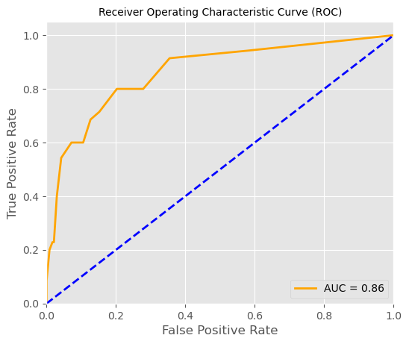
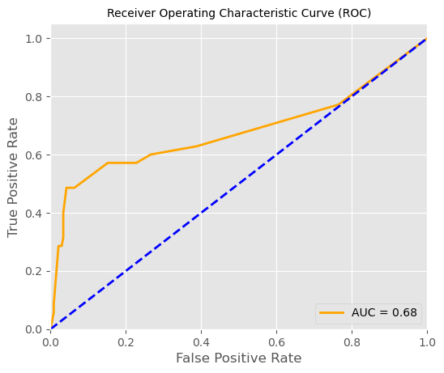
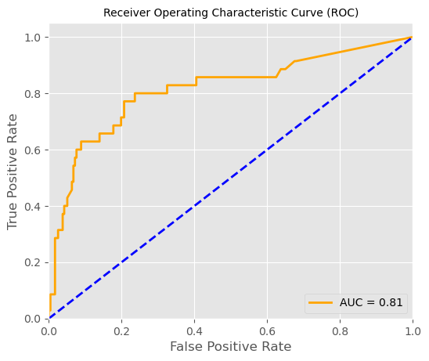
Area Under the Curve or AUC is basically
TPR vs FPR. Higher the AUC, better the performance of our model.
AUC KNN = 0.86
AUC Decision Tree = 0.68
AUC Random Forest = 0.81

Slide 7
Other Important Points
The dataset is highly unbalanced i.e. more than 80% of the wines have a quality rating of either 5 or 6.
There are plenty of outliers in each feature column. Though it’s always a good practise to treat outliers still I haven’t done it as it might affect the performance of our models.
There were also duplicate values which I’ve removed.
StandardScaler() performs the task of Standardization. Usually a dataset contains variables that are different in scale. For e.g. an Employee dataset will contain AGE column with values on scale 20 - 70 and SALARY column with values on scale 10000 – 80000.
(As these columns are different in scale, they are Standardized to have common scale while building machine learning models.)

